Slide 1
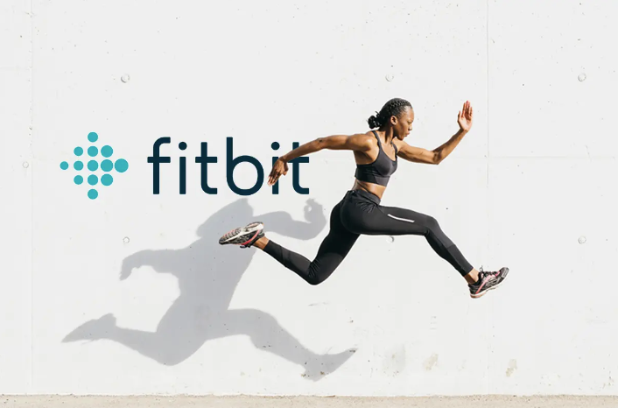
FitBit Influence on Exercise
Group 3

Slide 2

Summarising the data
Safety and security reasons around sensitive information that gets tracked:
age
gender and
geolocation
No public API
Requires express consent from the user
2 data sets of Fitbit daily activity summary on Kaggle
35 participants in a study
6 weeks in 2016
1397 recorded exercise sessions
Notes:
When looking for data to analyse Fitbit was very protective of their data and their privacy obligations, and we found that there was no public API for historical data, even de-identified data.
However, we did find 2 datasets on Kaggle, managed to merge them for this analysis.
Fitbit have marketed the “magic” goal of 10000 steps and have equated this to the guideline of 30 min of moderate intensity exercise a day.

Slide 3
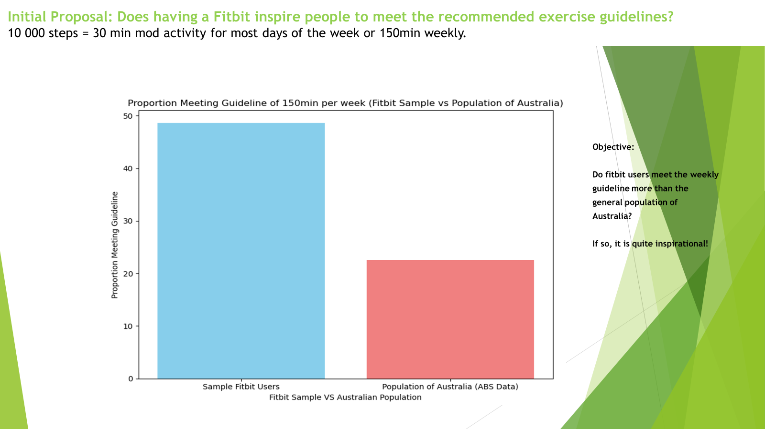

Slide 4
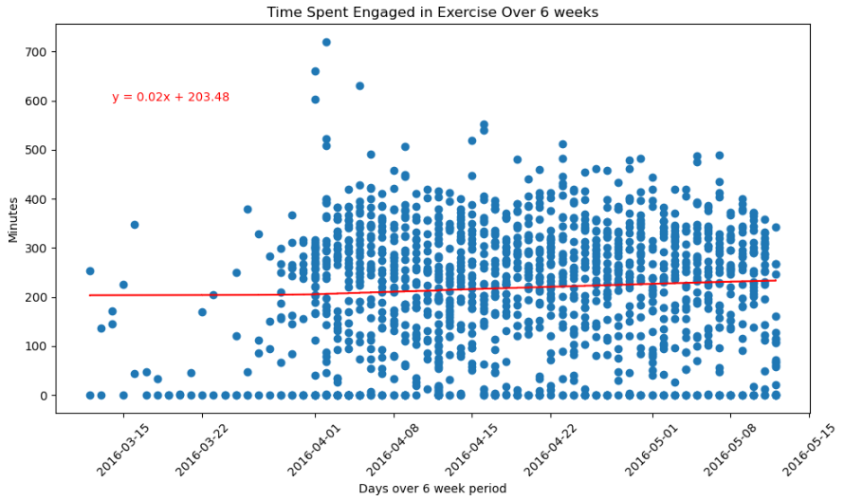
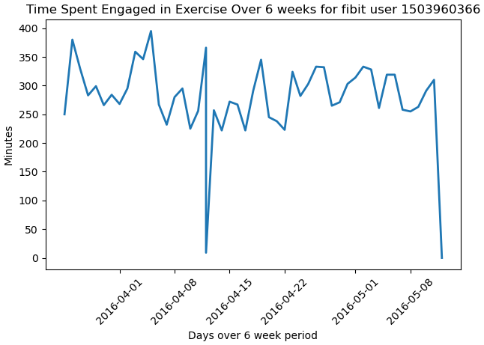
Time-Based Analysis
Is there a trend of minutes engaged in exercise over time?
Single VS multiple
Notes:
Stepping into my component of the project: for conducting time analysis
This graph is looking at some trends, across all intensity levels, this Fitbit user averaged about 300 min of activity a day.
Around the 12th he had a bad day and on the last day of the study he gave up his routine

Slide 5
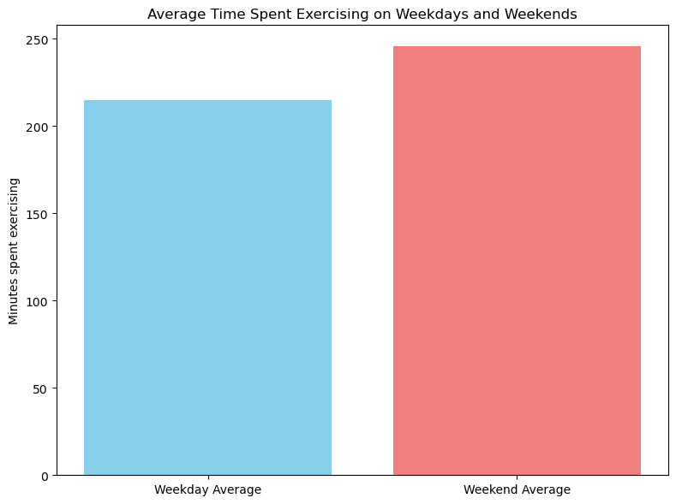
Is there a relationship between time spent engaging in exercise mid-week compared to weekends?
Notes:
So, investigated this. Creating 2 independent groups. Here you can see…
Why independent? The may have continued with their usual exercise routine.
Did some testing on this to see if it was statistically significant and found that Fitbit users exercise more on weekends.
Why is this important? So that fitbit can continue to maintain their sales levels, by remaining relevant:
Build a goal setting feature into Fitbit apps or other exercise communities can use this to help people to set a mid-week goal to match their weekend averages.
Build bootcamps and exercise groups meetups on Weekends to help people meet the exercise guidelines.
All of this helps helps Fitbit remain relevant.
I was certainly curious about this.

Slide 6
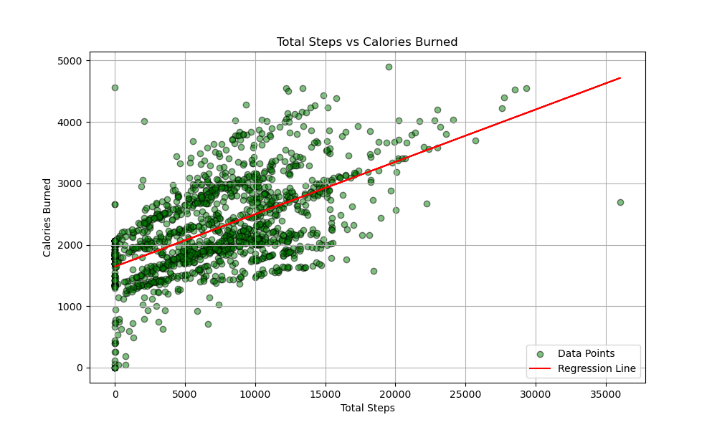
The graph shows that the more steps people take, the more calories they burn. Most of the participants are in the 0 to 15,000 step range.
Relationship between Total Steps and Calories burned:

Slide 7
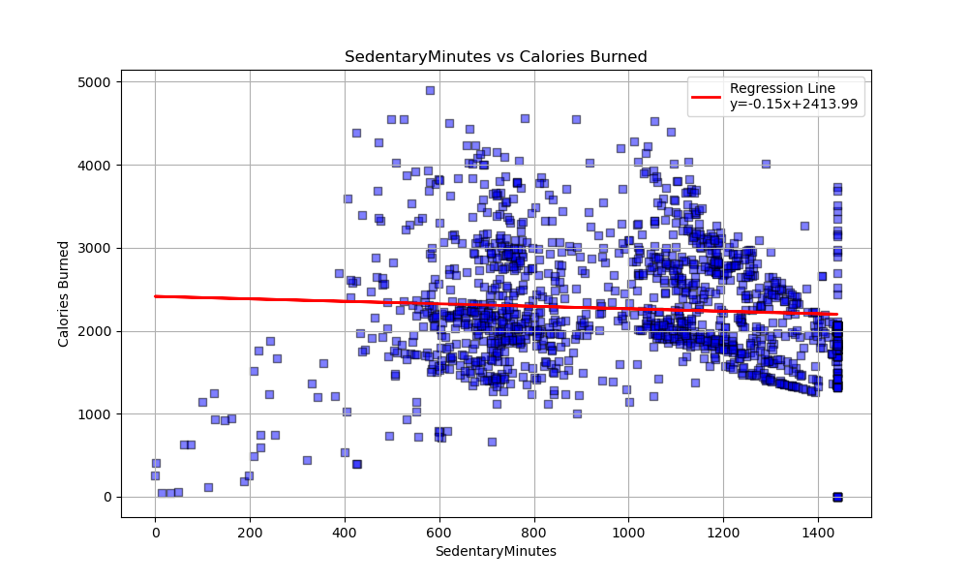
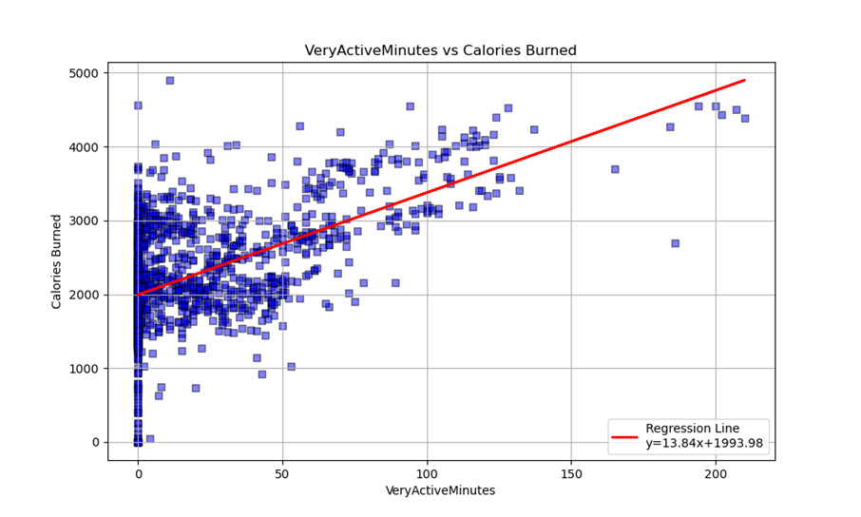
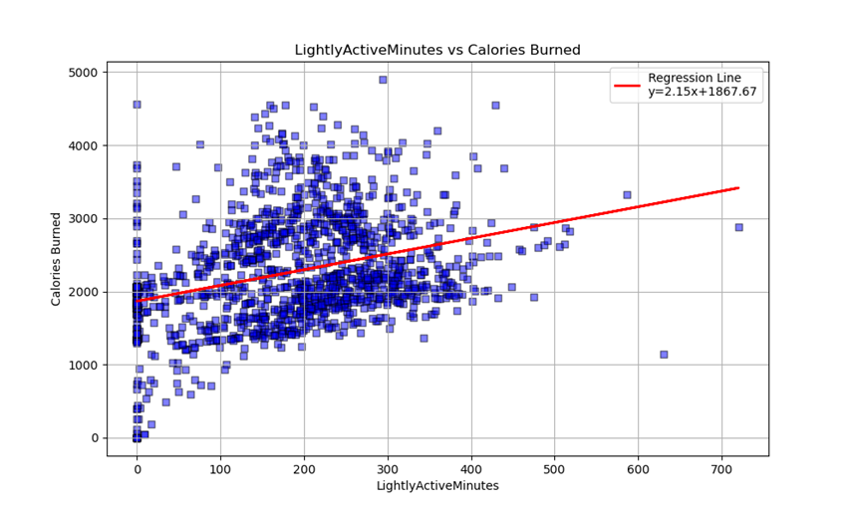
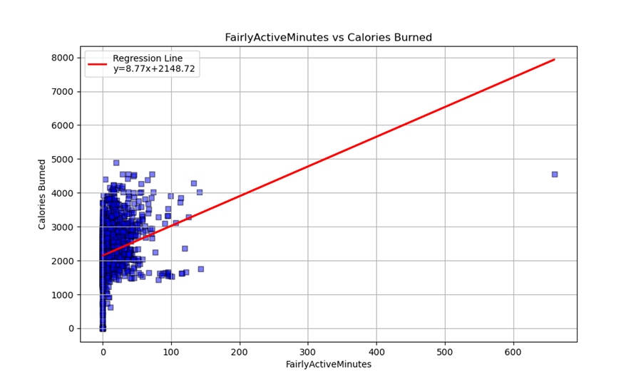
Which activity level contributes most to calorie burn?
These four graphs highlight the differences between activity levels in correlation with calories burned and the number of minutes.

Slide 8
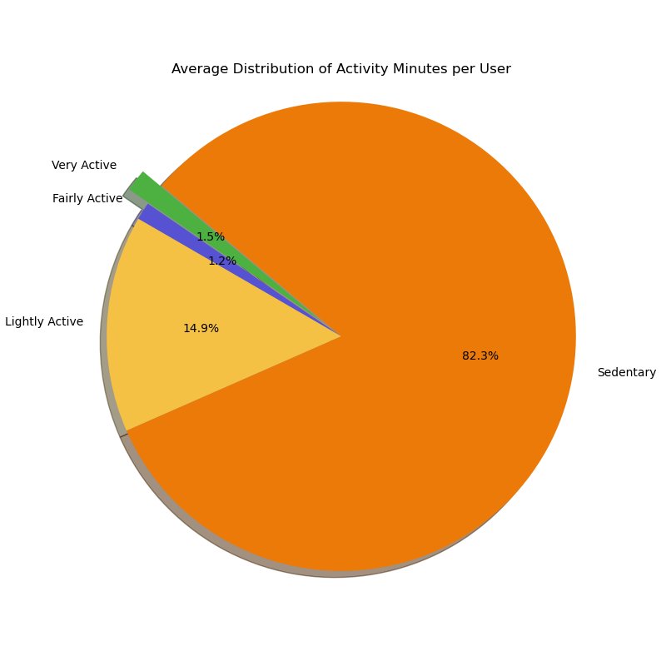
Percentage of activity levels based on activity minutes:
Is there a significant difference in the percentage of activity levels based on activity minutes?
The participants spend almost 2.7% of their time on fairly active and very active minutes, while the national standard is above 4%.

Slide 9
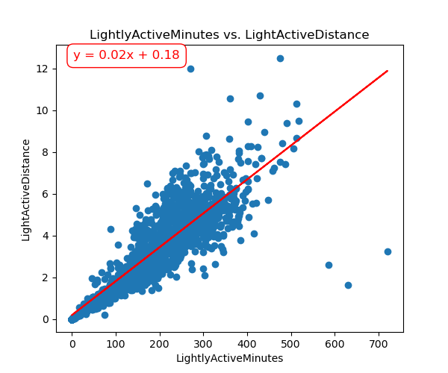
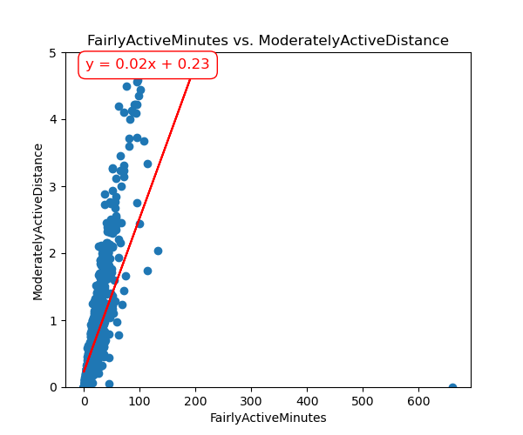
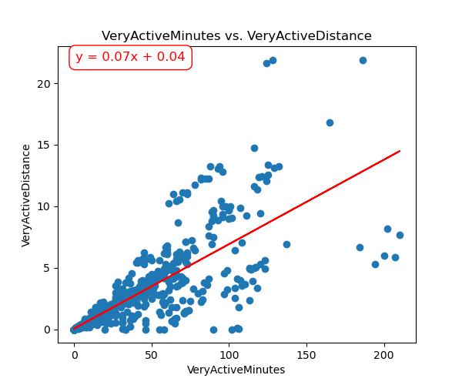
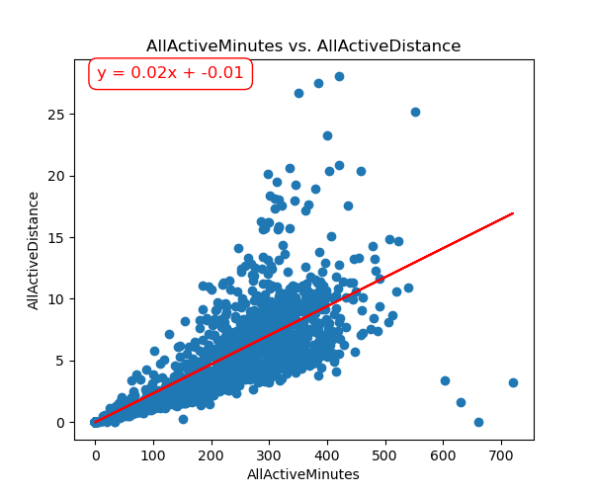
Correlations between activity minutes and distances:

Slide 10
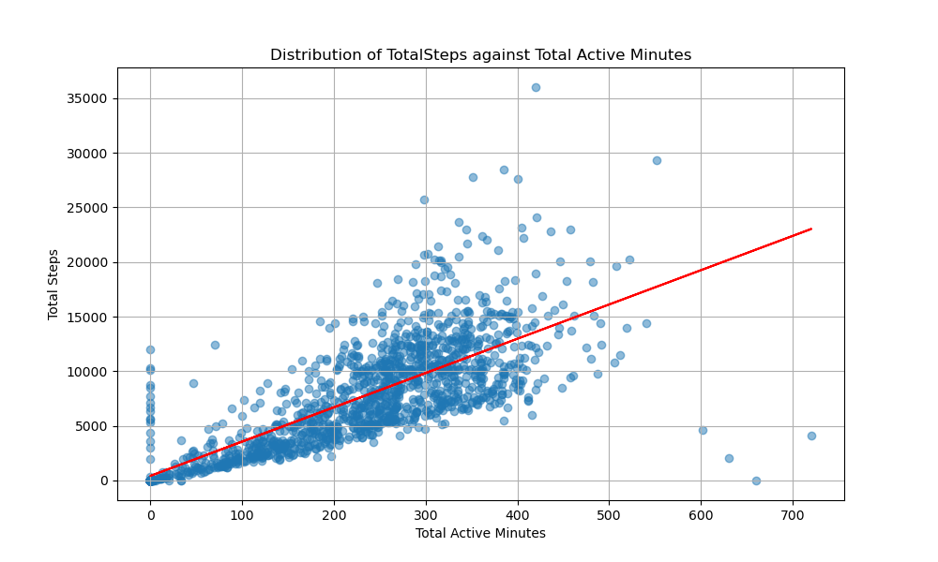
What is the distribution of TotalSteps against TotalActiveMinutes?

Slide 11
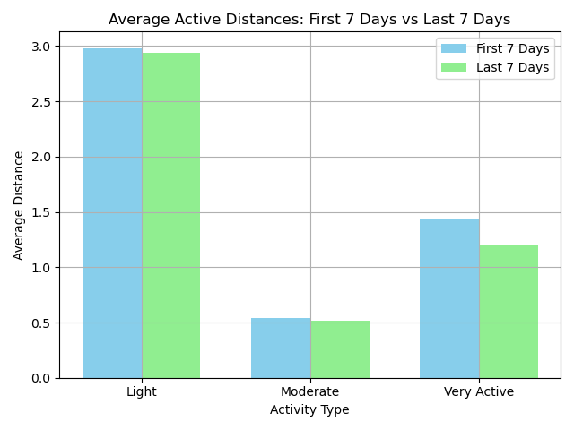
Hypothesis question
Is there a significant difference in the average active distances (Light, Moderate, and Very Active) between the first 7 days and the last 7 days of the survey to see if users improved over the duration of the survey?

Slide 12
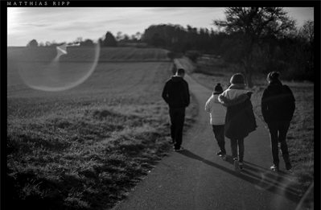
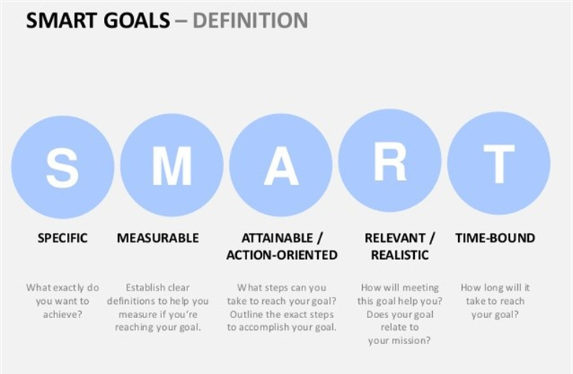
FitBit’s 10,000 Step Goal

Slide 13
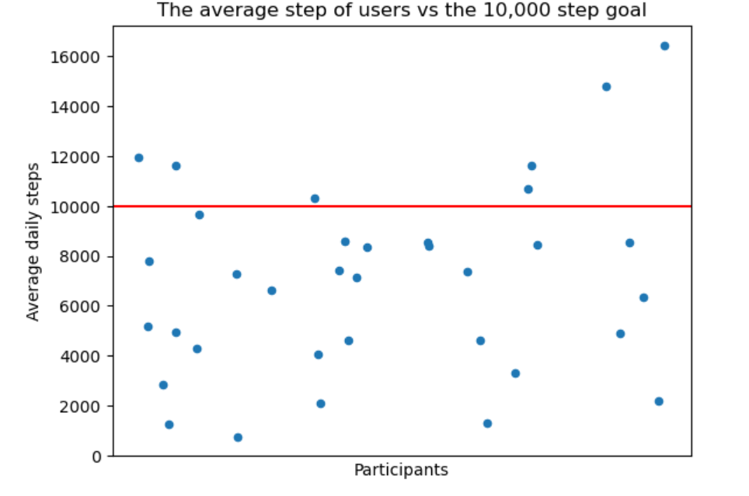
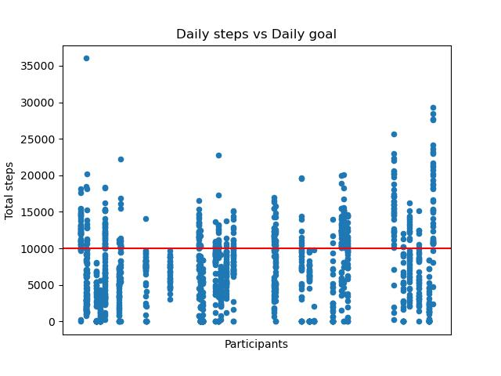
FitBit’s 10,000 Step Goal

Slide 14
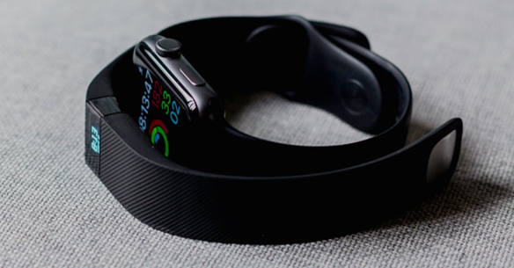
FitBit’s 10,000 Step Goal
Activity level | FitBit Sample | Australian Bureau
Sedentary | 37% | 21%
Lightly Active | 20% | 35%
Fairly Active | 23% | 28%
Very Active | 20% | 15%
ACTIVITY BRACKET BY STEPS
Sedentary is less than 5,000 steps
Lightly Active is between 5,000 and 7,500 steps
Fairly Active is between 7,500 and 10,000 steps
And Very active is above 10,000 steps.

Slide 15

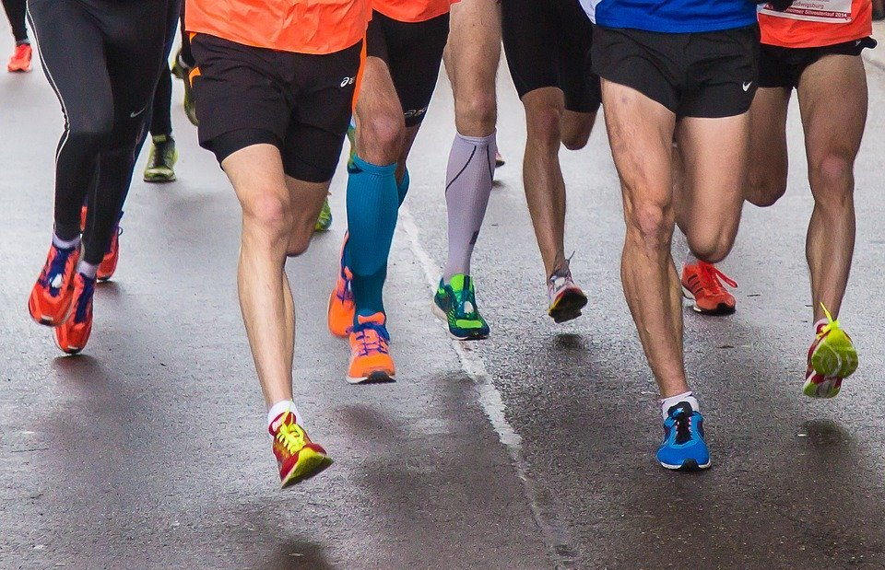
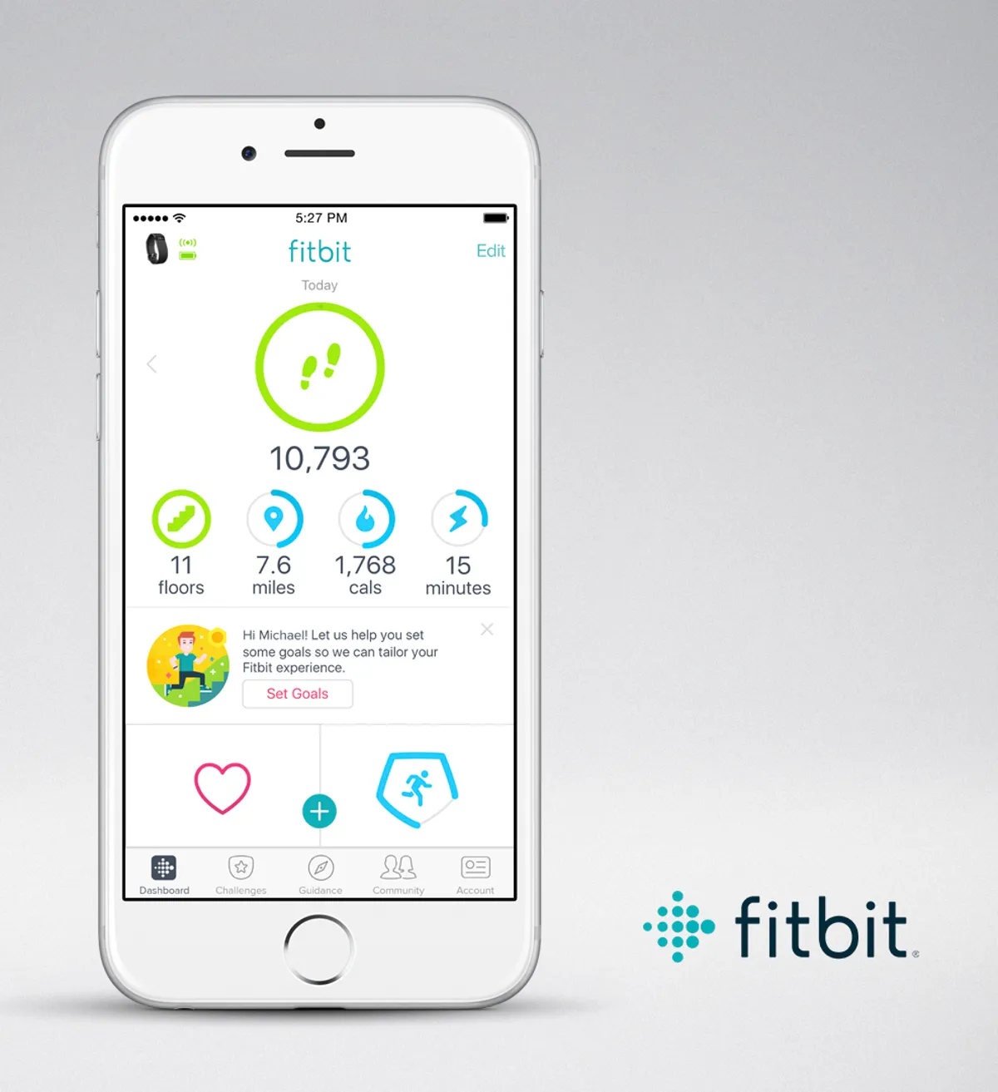
FitBit’s 10,000 Step Goal
Did FitBit Users tend towards different step brackets/ activity levels?
2. Is counting steps a good metric for activity levels?
3. Is the 10,000 steps a good approach for FitBit?
Notes:
Conclusions:
Fitbit users were evenly distributed in step activity level
The step activity level was consistent with Australian metrics for activity levels it.
the goal is hard to achieve on a regular basis and is impersonal, and possibly discouraging considering the general activity levels of users
Most participants were capable of reaching the goal, but generally struggles to maintain
Thos who purchased the fitbit showed a fairly even distribution of activity levels, implying that purchasing a fitbit and using the step measurement doesn’t exactly inspire higher activity levels.

Slide 16
Conclusion: Did Fitbit inspire users to exercise?
Overall, we found that users were more inclined to work out on the weekends, suggesting Fitbit should work on weekday user engagement and encouragement.
Fairly active to very active minutes and steps correlate to higher calorie burn and are the recommended daily activities of Fitbit. However, the majority of users were found to show lightly active and sedentary levels which is similar to the general public. We also found little improvement over the timeframe of the data.
Therefore, we conclude that Fitbit needs to work on inspiring their customers with a more personal approach for user engagement.
Next steps: from here we could investigate this further with a stronger dataset by collecting our own research population data using the Fitbit web API with users express consent.

Slide 17

Q&A

